Slide 1
Economics & Management
Lecture 7
Dua Agha
Lecturer
Dept. of Software Engineering

Slide 2
Introduction to COCOMO
COCOMO (Constructive Cost Model) is a widely used algorithmic software cost estimation model developed by Barry W. Boehm in 1981.
It is used to estimate the effort, cost, and schedule for software development projects.

Slide 3
Definition:
COCOMO provides a systematic approach to estimate the following:
Effort (Person-Months): The amount of labor required.
Time (Months): The development schedule or time to completion.
Cost: The overall cost to complete the project.
COCOMO considers various factors such as project size, complexity, and the capabilities of the development team to produce these estimates.

Slide 4
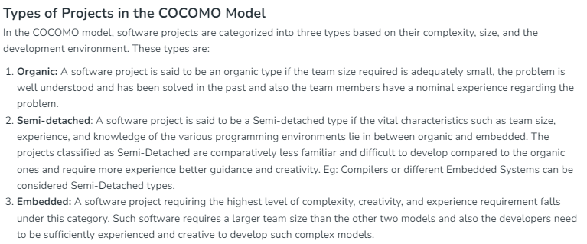

Slide 5
Examples Organic, Semidetached & Embedded
Organic projects are typically small, simple, and straightforward. They involve experienced teams working with familiar applications and environments.
Example: Small Business Accounting System, Inventory Management System, Basic Website Development & Mobile App for Personal Use
Semidetached projects have more complex requirements and involve a mix of experienced and inexperienced team members. These projects are larger and more challenging than organic projects but not as complex as embedded ones.
Example: Hospital Management System, E-commerce Website & Customer Relationship Management (CRM) System
Embedded projects are the most complex, involving real-time systems, hardware integration, and often mission-critical applications. They typically require extensive testing and validation. Example: Aircraft Navigation System, Medical Device Software(MRI/Pacemakers)

Slide 6
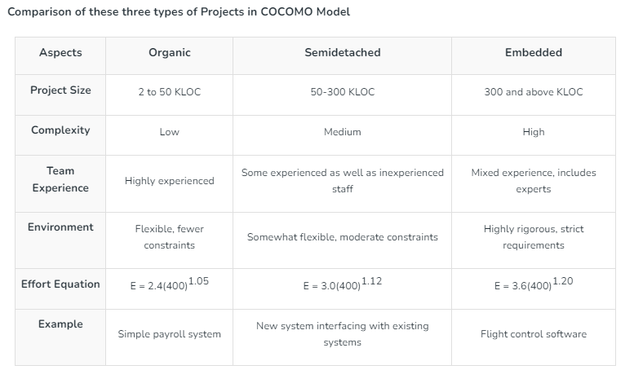

Slide 7
Development Effort and Schedule
COCOMO provides three levels of models, each with increasing accuracy and complexity:
Basic COCOMO
Intermediate COCOMO
Detailed COCOMO
Basic COCOMO:
The Basic COCOMO model is a straightforward way to estimate the effort needed for a software development project. It uses a simple mathematical formula to predict how many person-months of work are required based on the size of the project, measured in thousands of lines of code (KLOC).

Slide 8
2. Intermediate COCOMO takes Cost Drivers into account
3. Detailed COCOMO additionally accounts for the influence of individual project phases, i.e in case of Detailed it accounts for both these cost drivers and also calculations are performed phase wise henceforth producing a more accurate result. These two models are further discussed below.
Estimation of Effort: Calculations -
1. Basic Model – The given formula is used for the cost estimation of for the basic COCOMO model. The constant values a and b for the Basic Model for the different categories of system:
E = a*(KLOC)^{b}
Tdev = c*(E)^{d}

Slide 9
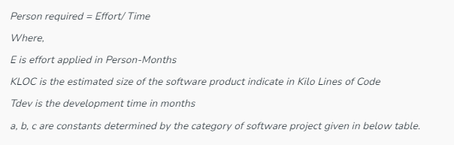
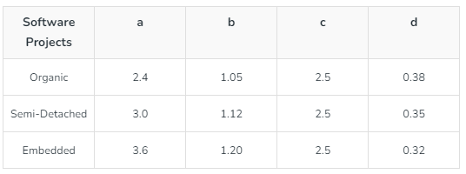
E = a*(KLOC)^{b}
Tdev = c*(E)^{d}

Slide 10
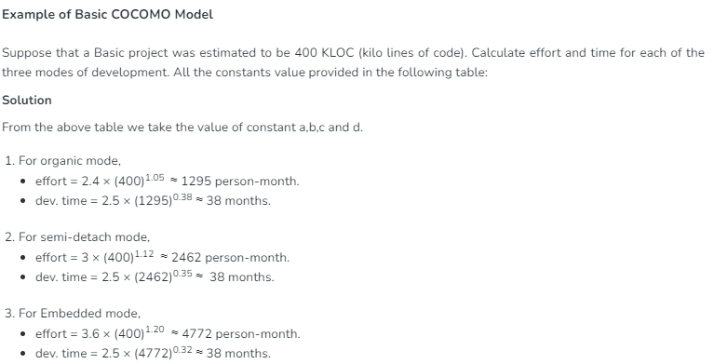
People or Staff Size = 1295/38 = 34.07 persons
People or Staff Size = 2462/38 = 64.78 persons
People or Staff Size = 4772/38 = 125.57 persons

Slide 11
DISATVANTAGES OF BASIC COCOMO MODEL
It considers only KLOC to estimate effort
It can not be used for modern tools
It does not consider different parameters
NOTE: Intermediate COCOMO model considers different parameters to estimate effort and time

Slide 12
INTERMEDIATE MODEL
The basic COCOMO model assumes that the effort is only a function of the number of lines of code and some constants evaluated according to the different software systems.
However, in reality, no system’s effort and schedule can be solely calculated based on Lines of Code.
For that, various other factors such as reliability, experience, and Capability.
These factors are known as Cost Drivers and the Intermediate Model utilizes 15 such drivers for cost estimation.

Slide 13
Classification of Cost Drivers and their attributes:
(i) Product attributes –
Required software reliability extent
Size of the application database
The complexity of the product
(ii) Hardware attributes –
Run-time performance constraints
Memory constraints
The volatility of the virtual machine environment
Required turnabout time

Slide 14
(iii) Personnel attributes –
Analyst capability
Software engineering capability
Applications experience
Virtual machine experience
Programming language experience
(iv) Project attributes –
Use of software tools
Application of software engineering methods
Required development schedule

Slide 15
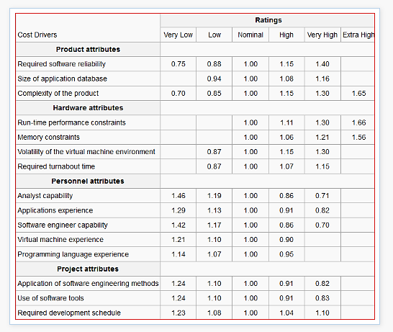
VALUES ASSIGNED TO VARIOUS PARAMETERS

Slide 16
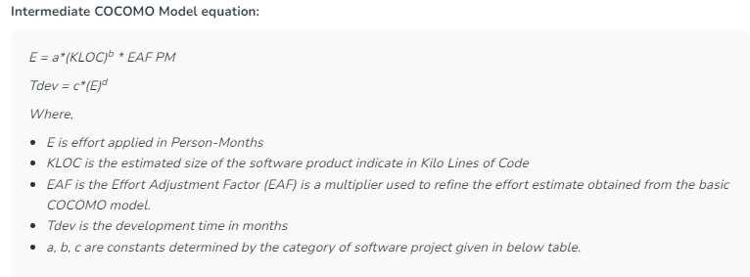
The project manager is to rate these 15 different parameters for a particular project. Then, depending on these ratings, appropriate cost driver values are taken from the above table. These 15 values are then multiplied to calculate the EAF (Effort Adjustment Factor). The Intermediate COCOMO formula now takes the form:

Slide 17
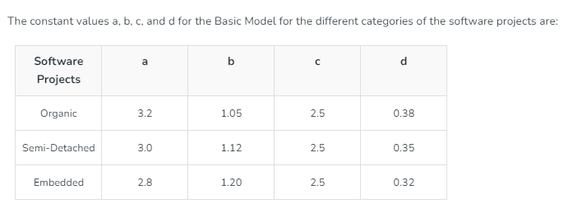

Slide 18
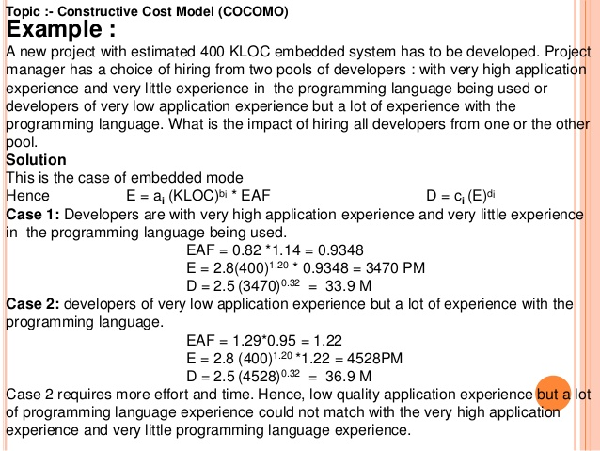

Slide 19
PROBLEM:
A Software house has assigned to develop Software for SECURITY SYSTEM (Embedded System) with 60,000 LOC. Reliability must be very high (RELY=1.40). Calculate effort, time duration and number of persons required for Project.
Re-Calculate effort, time duration and number of persons required for Project. the project is rated Very High main storage constraint of 1.21, application experience is high 0.91 and low for language & tools experience effort multiplier of 1.10. also explain the impact of cost drivers.

Slide 20
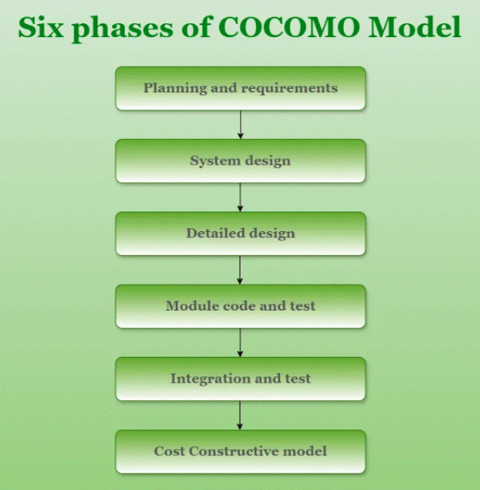
Detailed COCOMO

Slide 21
Planning and requirements: This initial phase involves defining the scope, objectives, and constraints of the project. It includes developing a project plan that outlines the schedule, resources, and milestones
System design: In this phase, the high-level architecture of the software system is created. This includes defining the system’s overall structure, including major components, their interactions, and the data flow between them.
Detailed design: This phase involves creating detailed specifications for each component of the system. It breaks down the system design into detailed descriptions of each module, including data structures, algorithms, and interfaces.
Module code and test: This involves writing the actual source code for each module or component as defined in the detailed design. It includes coding the functionalities, implementing algorithms, and developing interfaces.
Integration and test: This phase involves combining individual modules into a complete system and ensuring that they work together as intended.
Cost Constructive model: The Constructive Cost Model (COCOMO) is a widely used method for estimating the cost and effort required for software development projects.

Slide 22
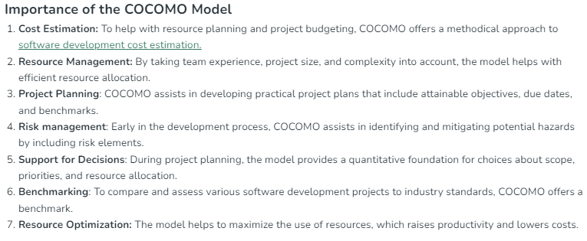

Slide 23
